Slide 1
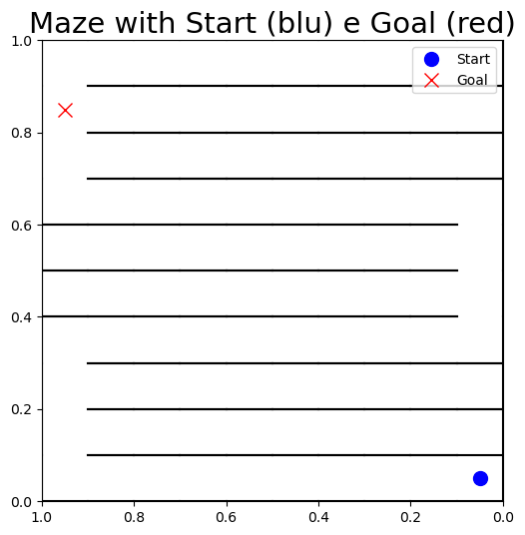
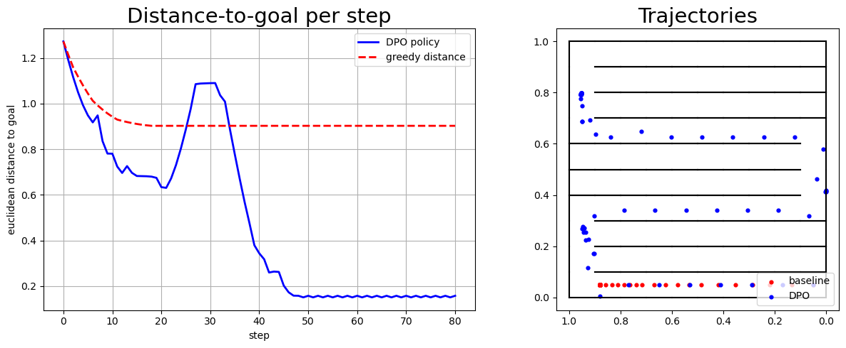
No reward? No problem: Training Maze Agents with Preferences
Giovanni Filomeno
Supervisor: Vihang Patil
🔥
Motivation:
💼📊
Workflow:
Breaking: m
Environment: I designed a custom 2D maze environment with winding “S-shaped” corridors that challenge naive strategies.
Point Generation: I generated thousands of random points (states) within the Maze
Preference: For each pair of points, I computed a custom preference score based on: distance to goal, distance to wall, death end, real distance
Learning with DPO: A neural network was trained to model preferences, learning to assign higher scores to better states. The training objective was to rank preferred points higher — effectively shaping a reward-free value function.
Sensitivity (Future Work): The final policy was heavily influenced by the way we designed the scoring function. Small changes in how we penalized dead-ends or long paths led to drastically different behaviors, highlighting the importance of well-designed preferences.
Traditional reinforcement learning relies on dense, well-designed rewards, but these are hard to define in complex environments like mazes.
database generation of random points in the maze
Generation of the preferences
Training of the DPO
⚠️
Challenge:
How can we train an agent to navigate effectively without access to a handcrafted reward function?
💡
Idea:
Use Direct Preference Optimization (DPO) to teach the agent via comparisons between good and bad trajectories, learning a policy that reflects desired behaviors.
Introduction:
In many real-world tasks, defining a precise reward function is difficult or even misleading.
Preference-based learning offers a flexible alternative: agents learn by comparing which behaviors are better.
Direct Preference Optimization (DPO) is a scalable method to learn from pairwise preferences without explicit rewards.
We apply DPO to train agents in 2D maze environments, learning to navigate effectively using only trajectory comparisons.
🔥
Results: DPO can escape from Maze

